Slide 1

Bharat Alert – Web-Based Child Abduction Alert System
Department of Computer Science and Engineering
BATCH - 31
GUIDE
HOD
Sushanth Goud M -227Y1A05I3
Tejesh V -227Y1A05I4
Mrs. Anusha Kolli
Associate Professor
Dr . K. Abdul Basith

Slide 2
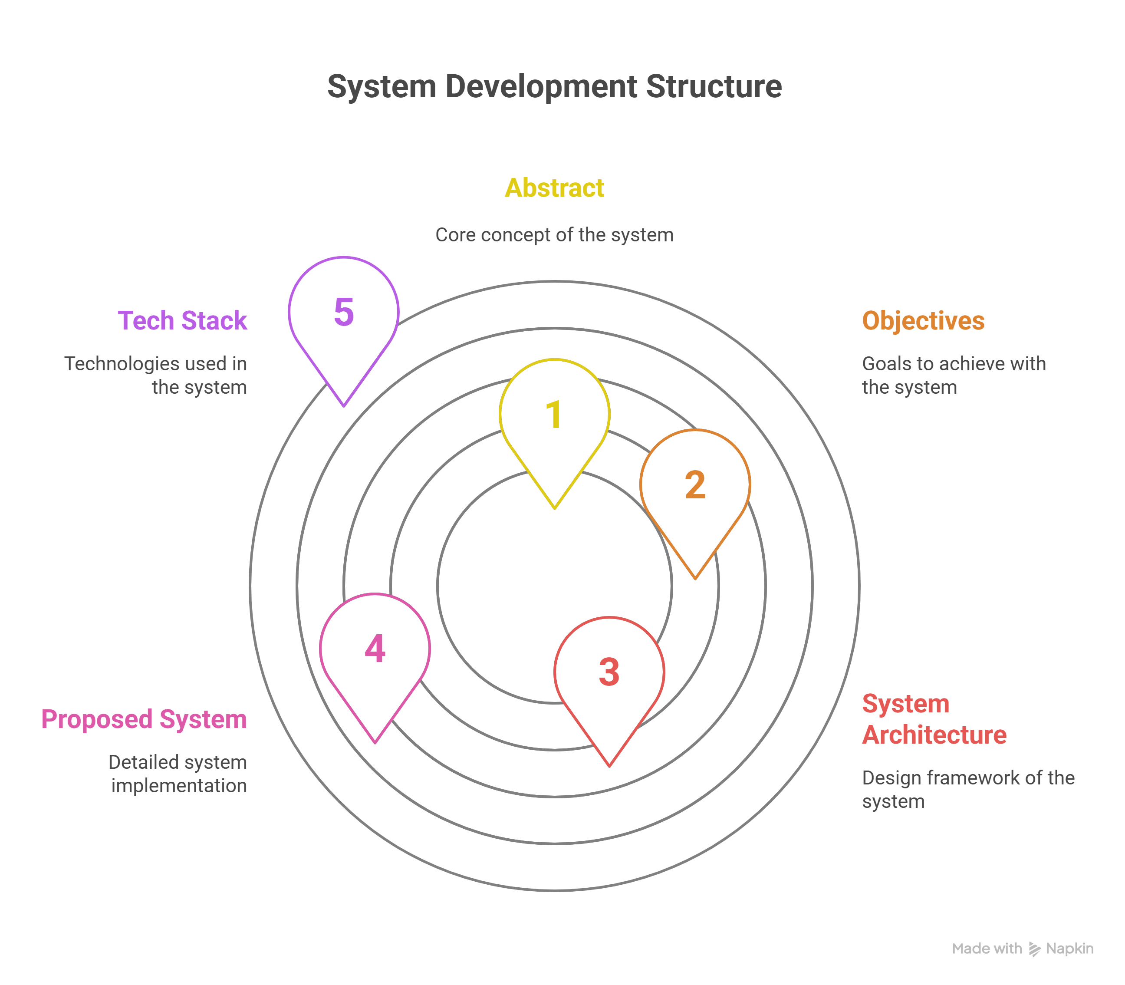
Index
Abstract
Objectives
System Architecture
Proposed System
Tech Stack
Key Features
User Flow
Pages Overview
Admin Dashboard
Public Alert Board
Conclusion
References

Slide 3
Abstract
Bharat Alert directly addresses the SIH Problem Statement ID: 179 by providing a web-based platform that simulates a face-recognition surveillance and communication system for missing persons, with a special focus on child abduction cases in India. This project’s significance lies in its ability to combine public reporting, administrative review, and real-time mapping into an integrated workflow that can raise awareness and accelerate community response.
Core Features:
User report submission (name, age, last-seen location + map pin)
Admin approval/rejection and “Solved” marking
Public Alert Board displaying approved cases on a live map
Community sighting feedback tied to each report
Significance: Prototype for NGOs and law-enforcement, demonstrating how low-cost, scalable web tools can enhance community response in missing-person scenarios

Slide 4
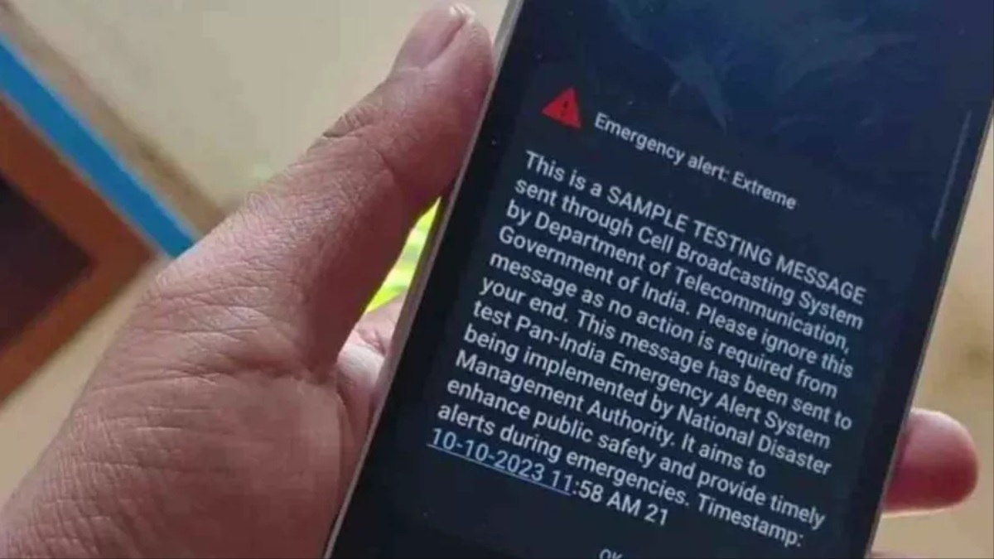
Objectives
Demonstrate a low-cost web-based child-abduction alert platform with end-to-end workflow
Integrate with India’s National Emergency Alert System (cell-broadcast SMS) to push missing-child notifications directly to mobile users
Enable real-time admin moderation: approve, reject, or mark reports as “Solved”
Support community engagement via sighting feedback that updates public alerts and SMS channels
Provide a deployable prototype for NGOs, law enforcement, and government agencies to leverage web and SMS networks for enhanced public safety

Slide 5
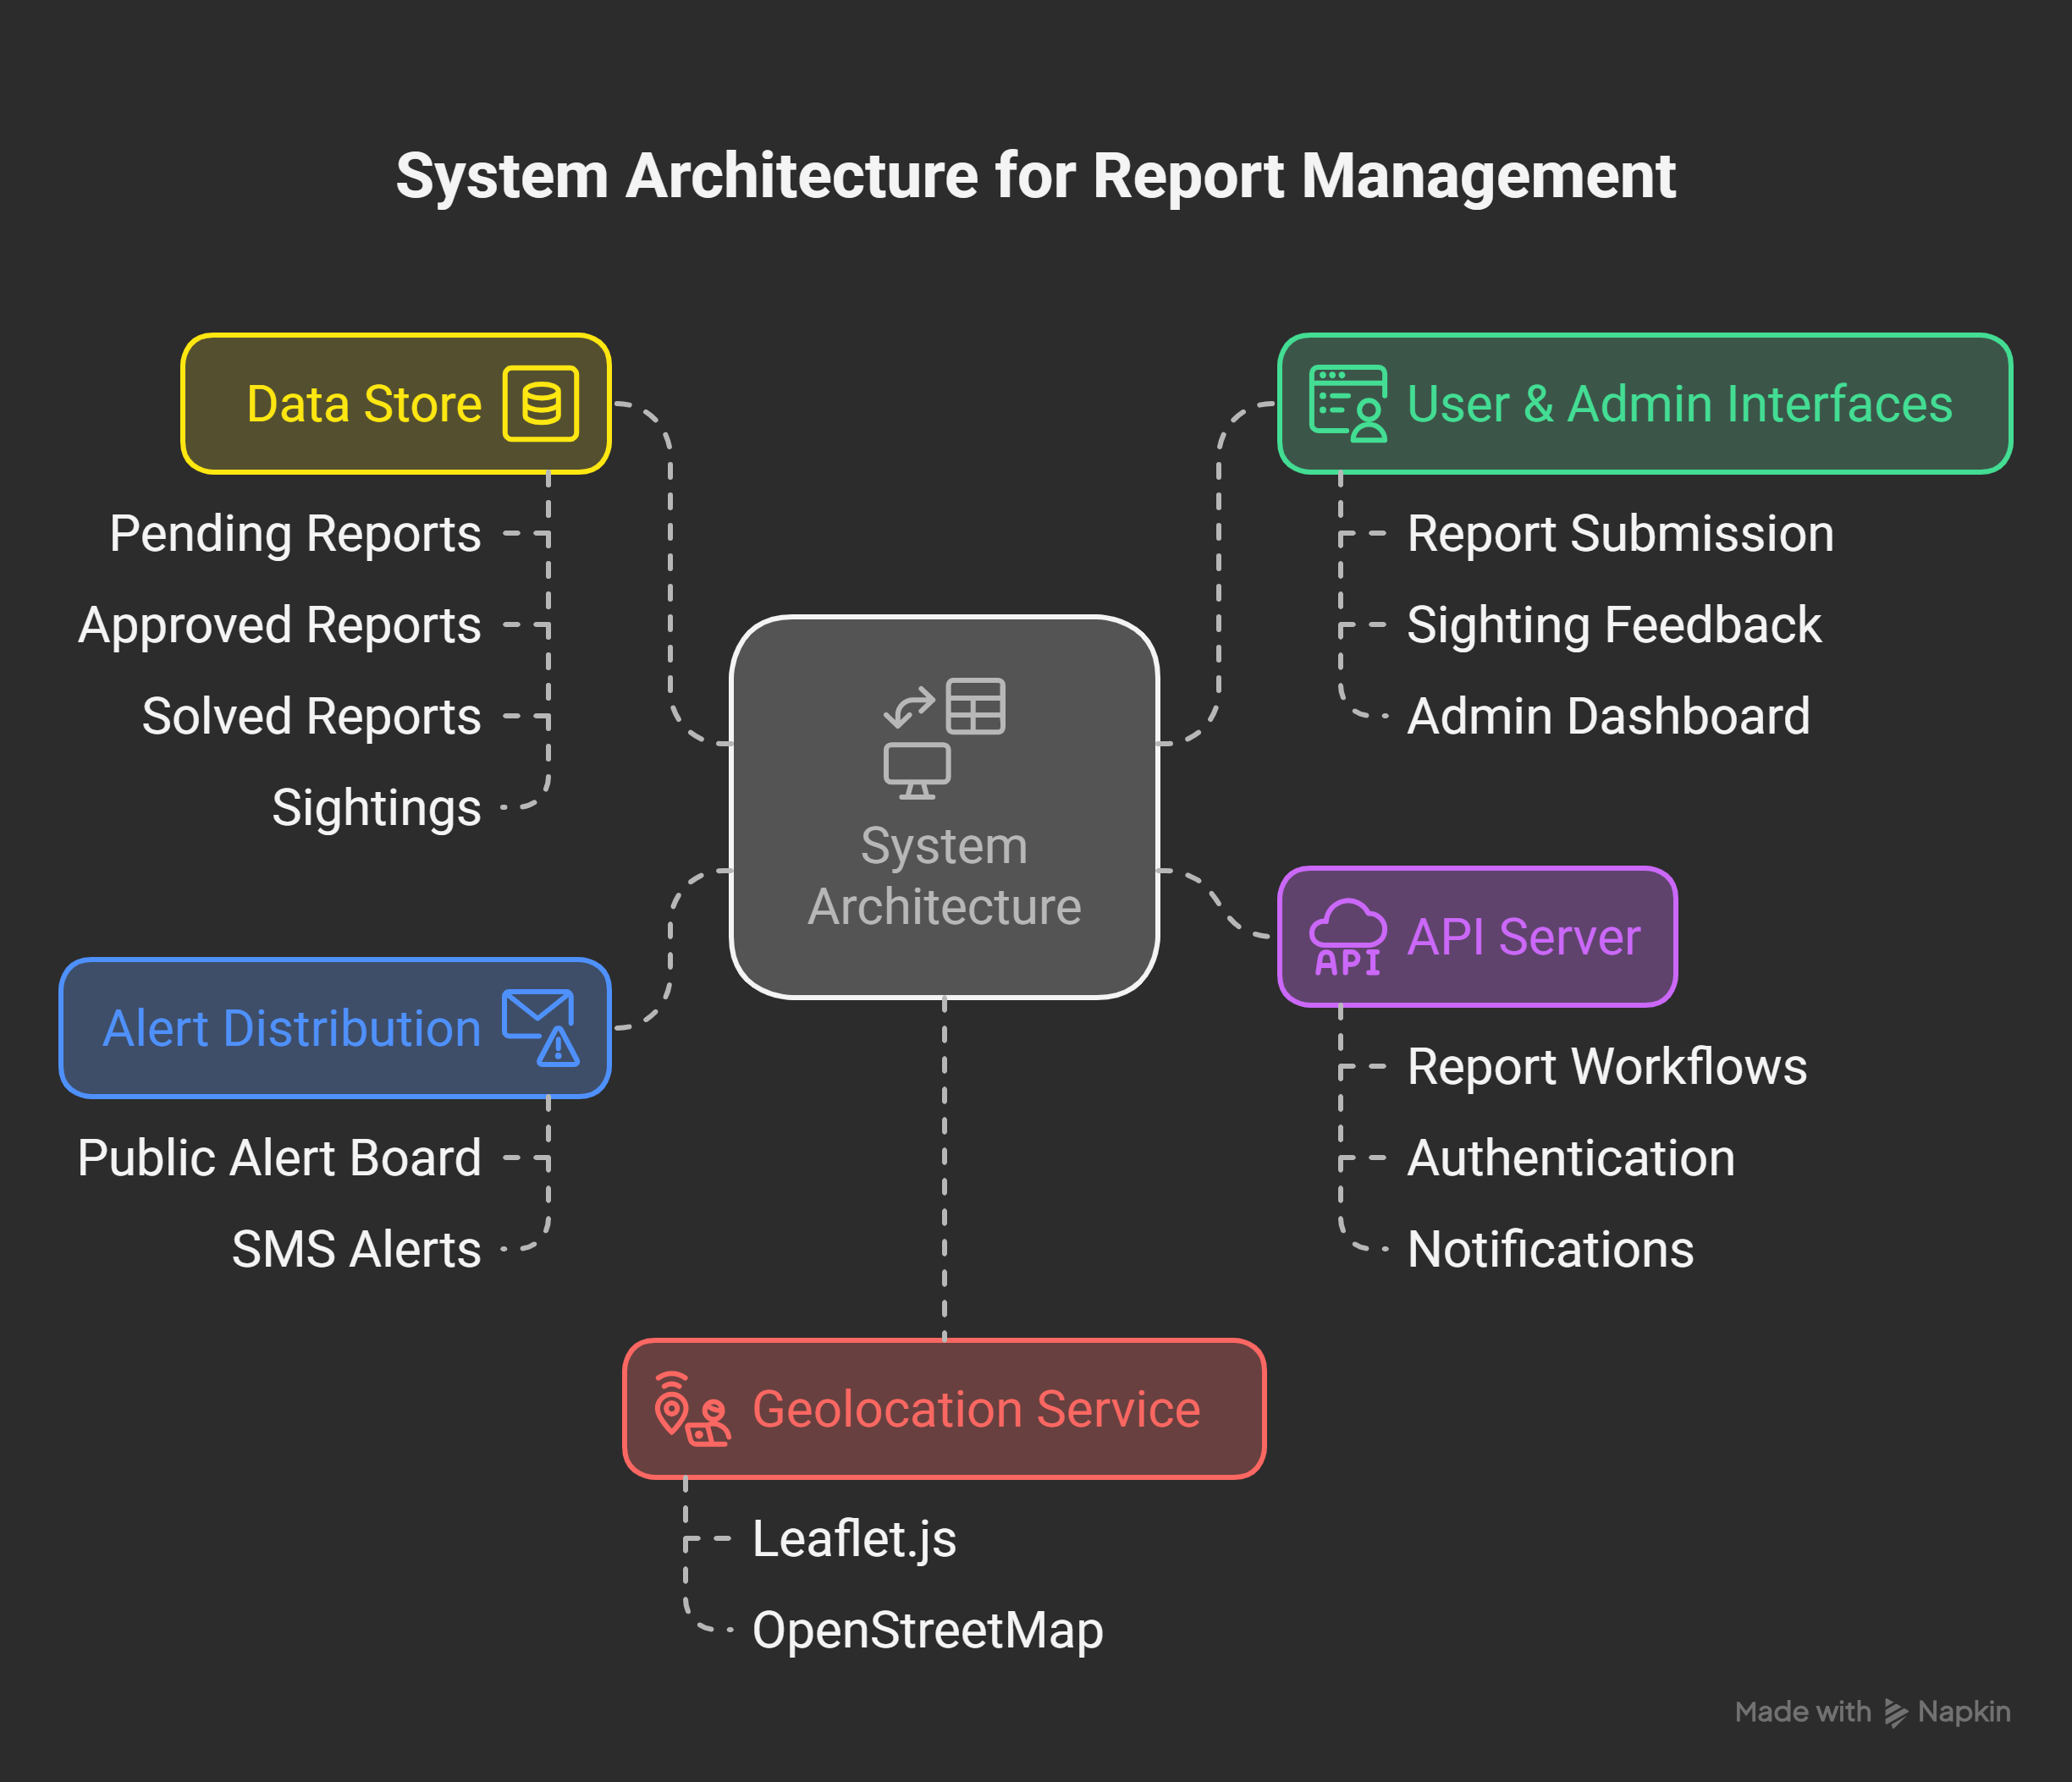
System Architecture
User & Admin Interfaces: Web forms for report submission, sighting feedback, and admin dashboard
API Server: REST endpoints handling report workflows, authentication, and notifications
Data Store: JSON-based backend (pending, approved, solved reports + sightings)
Alert Distribution: Publishes approved cases to the Public Alert Board and pushes SMS via India’s Emergency Alert gateway
Geolocation Service: Leaflet.js/OpenStreetMap integration for pinning locations and updating maps in real time

Slide 6

Proposed System
Face-Recognition & LPR Integration: Automatically match uploaded photos and license-plate numbers against reported cases for faster identification.
Digital Signage & Highway Alerts: Push alerts to roadside billboards and dynamic highway message signs displaying vehicle details and last-seen locations.
Multi-Channel Distribution: Combine India’s Emergency Alert SMS gateway with mobile push notifications, in-app banners, radio broadcasts, and digital billboards.
Robust Database: Upgrade from JSON stub to scalable DB (MongoDB/Firebase) for persistent storage, replication, and analytics.
Role-Based Access Control: Secure JWT/OAuth authentication for NGOs, police, volunteers, and public users with tailored dashboards.
Real-Time Analytics: Dashboards showing alert volumes, approval latencies, sighting heat-maps, and geospatial trends.
Advanced Mapping: Heat-map clustering of sightings, reverse-geocoding for addresses, and customizable map overlays.

Slide 7
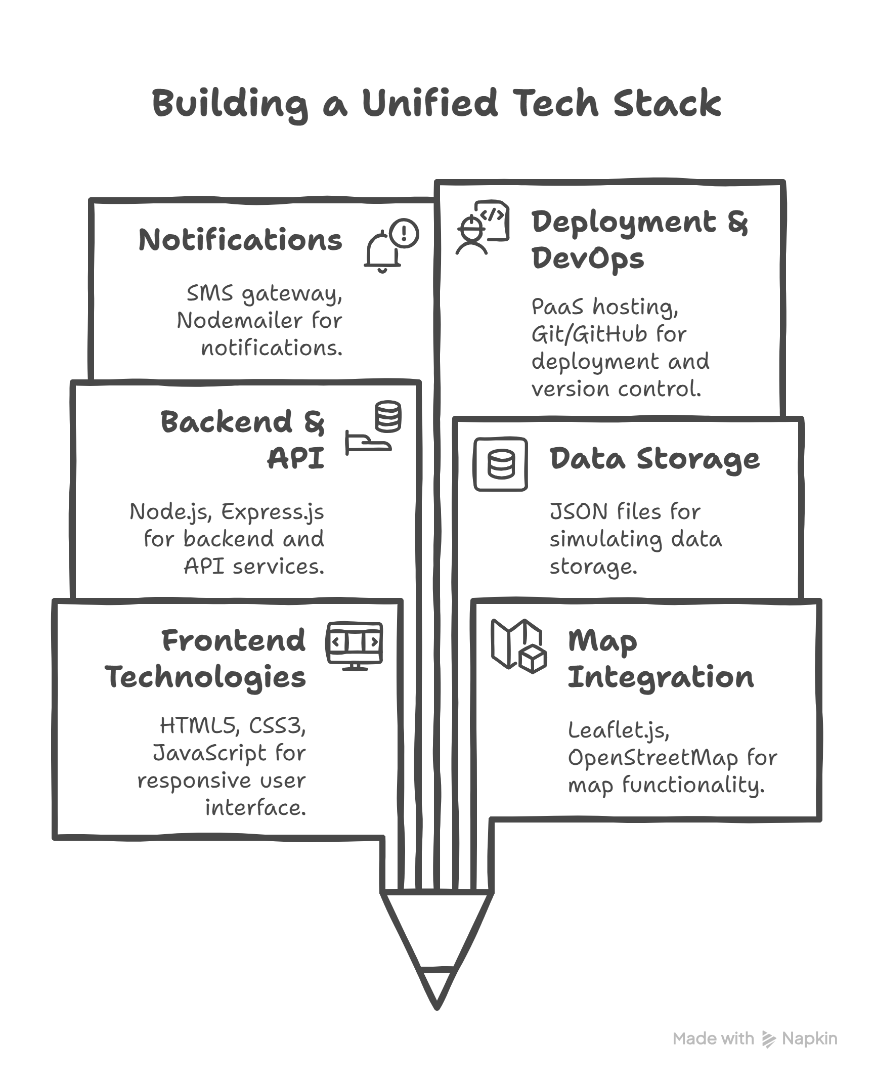
Tech Stack

Slide 8
Pages Overview
/submit-report A user-facing form to enter missing-child details (name, age, gender), last-seen location (with map pin), date/time, contact info, and optional photo.
/admin-dashboard Restricted area for administrators to view pending reports, approve or reject them, and mark cases as “Solved.”
/alerts Public Alert Board displaying all approved cases on an interactive map, with summary cards and filter options.
/report/:id Detailed page for a specific case, showing full report data and a “Submit Sighting” button.
/sighting/:id Form where community members can report sightings tied to a particular case, including location pin and comments.

Slide 9
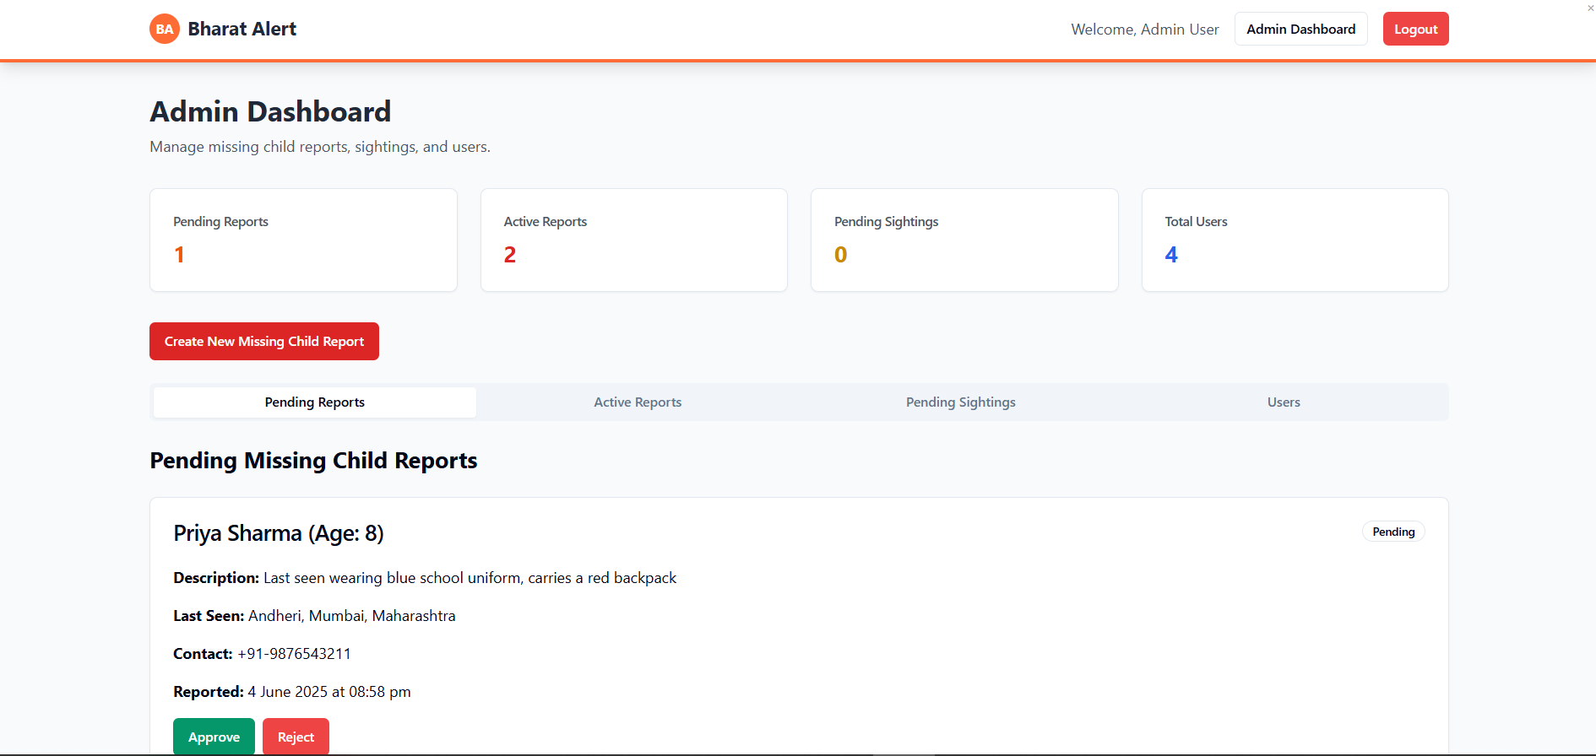
Admin Dashbaord

Slide 10
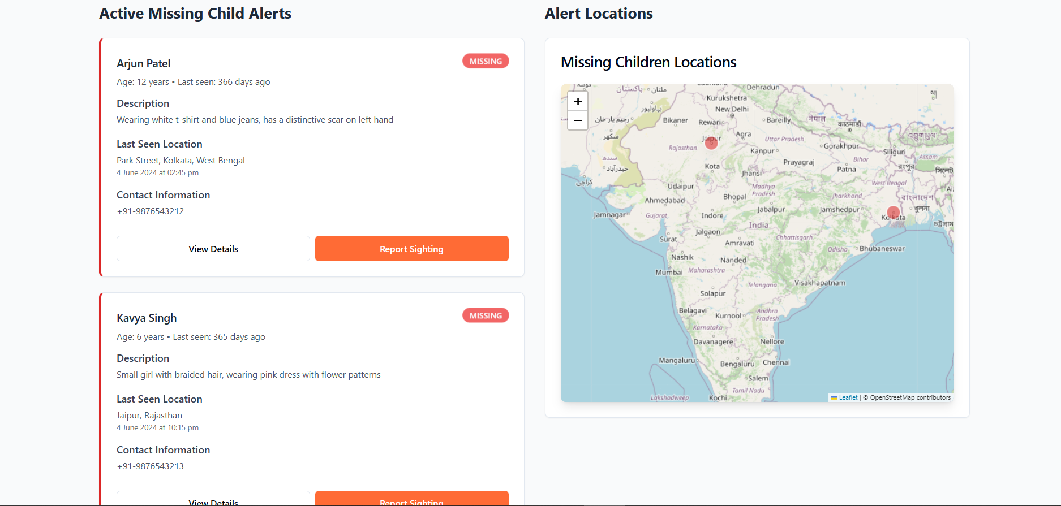
Home Page

Slide 11
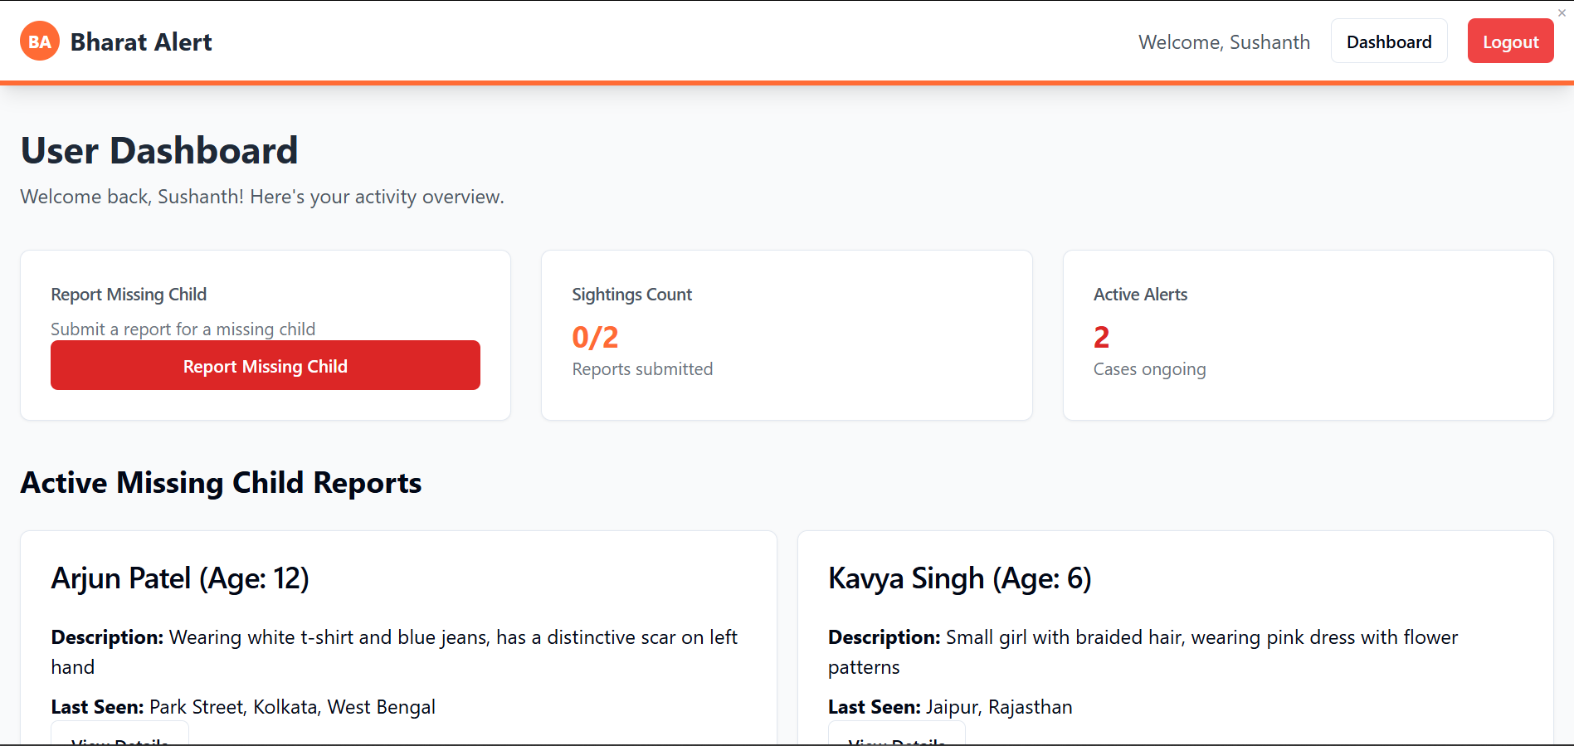
User Dashbaord

Slide 12
Roadmap & Enhancements
Automated Identification Integrate face-recognition and license-plate-recognition modules linked to CCTV feeds for real-time, hands-free matching against active alerts.
Robust Backend & Security Migrate from JSON files to a scalable cloud database (e.g., MongoDB/Firebase), implement JWT/OAuth authentication, and add audit logging for production-grade reliability.
Omni-Channel Alerting Beyond SMS, rollout mobile push notifications, a dedicated mobile app, and digital signage (billboards/highway message signs) to maximize reach and engagement.

Slide 13
Conclusion
Bharat Alert demonstrates a practical, low-cost approach to child-abduction reporting and response by merging web-based workflows with geolocation and emergency SMS channels. Through its intuitive interfaces for users and administrators, interactive map features, and modular architecture, it showcases how scalable digital tools can streamline end-to-end alert management. As a prototype, it paves the way for future enhancements—such as automated recognition, robust backend security, and multi-channel distribution—to evolve into a production-ready system that empowers communities, NGOs, and law-enforcement agencies in safeguarding missing children.

Slide 14
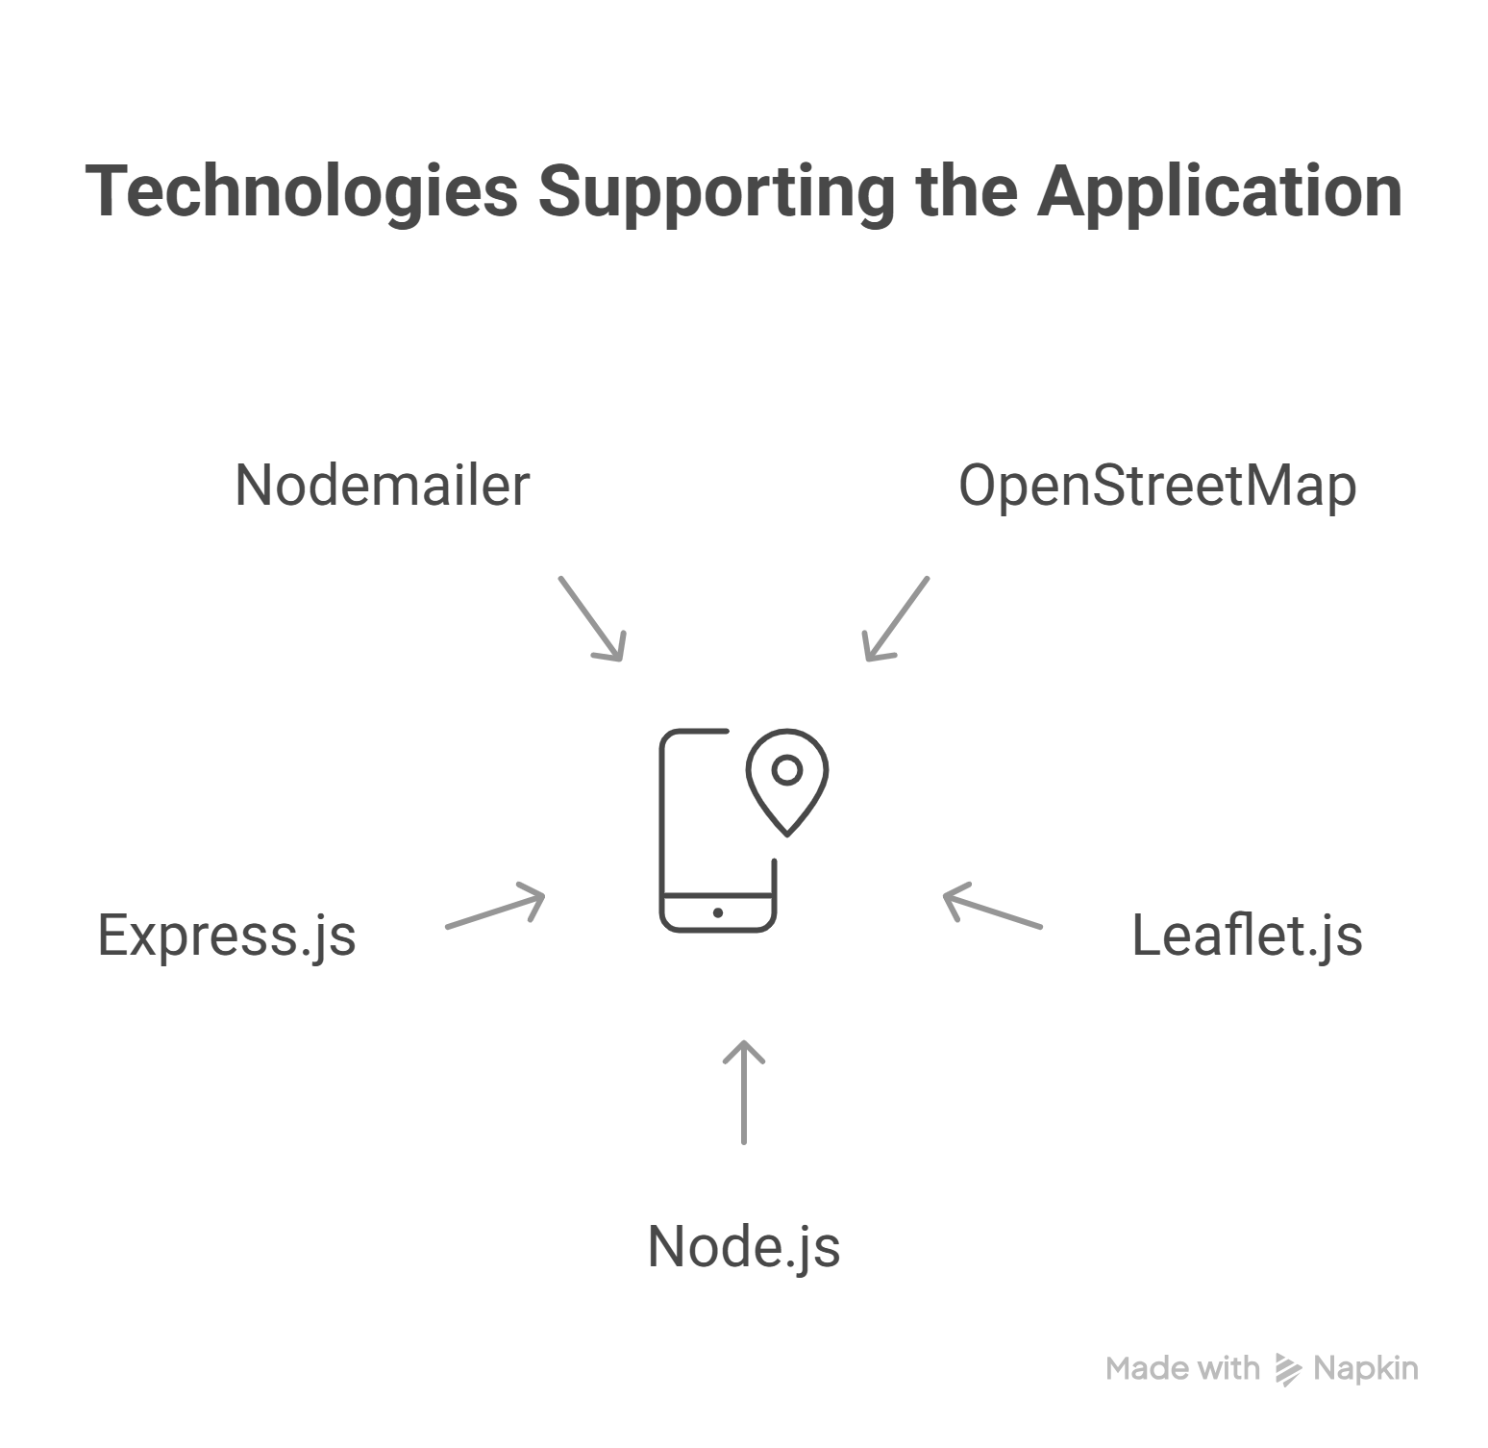
References
OpenStreetMap Foundation. (n.d.). OpenStreetMap. https://www.openstreetmap.org
Leaflet. (n.d.). Leaflet.js. https://leafletjs.com
Node.js Foundation. (n.d.).Node.js
https://nodejs.org
OpenJS Foundation. (n.d.). Express.js. https://expressjs.com
Reinman, A. (n.d.). Nodemailer. https://nodemailer.com

Slide 15
Thank You
Presented by: TEJESH VEERLA (227Y1A05I4) SUSHANTH MARDA (227Y1A05I3) CSE-B, MLRITM

